Slide 1
Applied Data Science Regression
Dr. Omri Allouche
2017

Slide 2
Correlation / Causation
Do ice cream sales lead to more drownings?
Big problem with big data – when having many variables
Notes:
Many variables – large chances of significant p-value with a type 1 error.

Slide 3
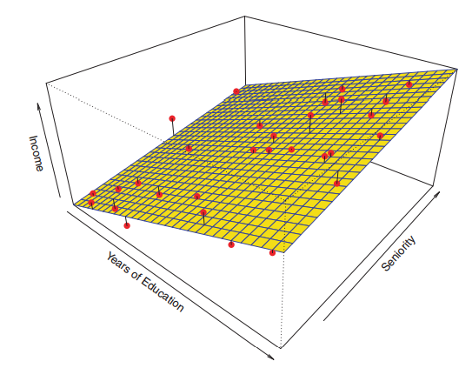
Notes:
Source: http://www-bcf.usc.edu/~gareth/ISL/ISLR%20Sixth%20Printing.pdf

Slide 4

Variance-Bias Trade-off
the expected test MSE, for a given value x0, can always be decomposed into the sum of three fundamental quantities: the variance of ˆf(x0), the squared bias of ˆf(x0) and the variance of the error variance bias terms .

Slide 5
Variance refers to the amount by which ˆf would change if we estimated it using a different training data set
bias refers to the error that is introduced by approximating a real-life problem, which may be extremely complicated, by a much simpler model
as we use more flexible methods, the variance will increase and the bias will decrease.

Slide 6
Limitations
Works only on numeric features
Doesn’t handle missing values well
Sensitive to outliers
Assumes linear relationships
Doesn’t handle colinearity well

Slide 7
Classification
One can show that the test error rate given in (2.9) is minimized, on average, by a very simple classifier that assigns each observation to the most likely class, given its predictor values

